Slide 1
Data Preprocessing ——Data Integration and Transformation——
徐华
清华大学 计算机系 智能技术与系统国家重点实验室
xuhua@tsinghua.edu.cn

Slide 2
Data Preprocessing
About data
Why preprocess the data?
Descriptive data summarization
Data cleaning
Data integration and transformation
Data reduction
Discretization and concept hierarchy generation
Summary

Slide 3
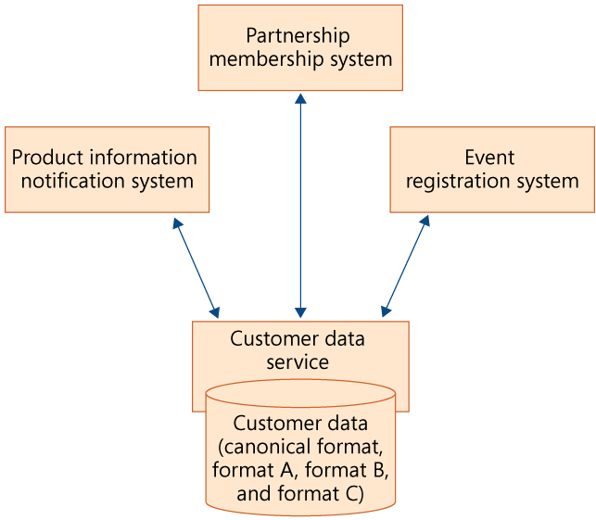
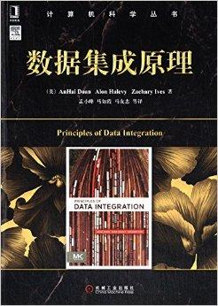
Data Integration
Data integration(数据集成):
Combines data from multiple sources into a coherent store
Schema integration (schema集成)
Integrate raw data from different sources
Entity identification problem: identify real world entities from multiple data sources, e.g., A.cust-id ≡ B.cust-#
Detecting and resolving data value conflicts (值冲突)
For the same real world entity, attribute values from different sources are different
Possible reasons: different representations, different scales, e.g., metric vs. British units

Slide 4
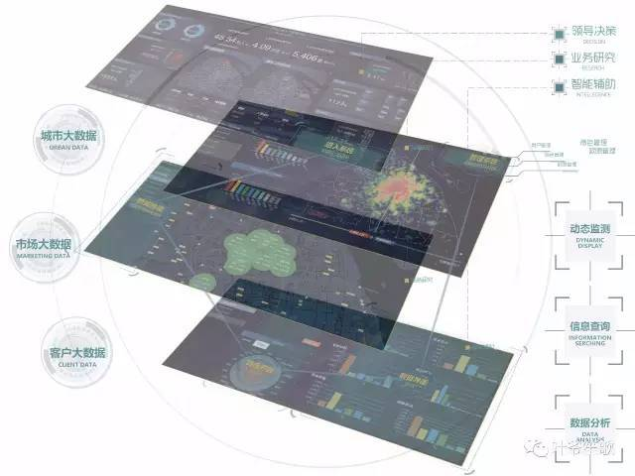
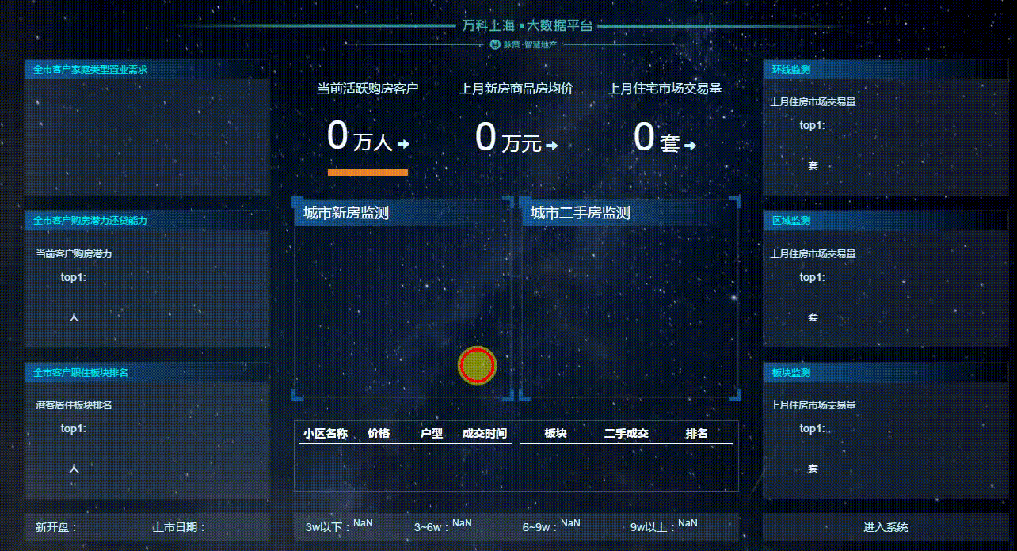
Handling Redundancy in Data Integration
Redundant data occur often when integration of multiple databases
Object identification: The same attribute or object may have different names in different databases
Derivable data (导出性数据): One attribute may be a “derived” attribute in another table, e.g., annual revenue（年度税收）
Redundant attributes may be able to be detected by correlation analysis
Careful integration of the data from multiple sources may help reduce/avoid redundancies and inconsistencies and improve mining speed and quality

Slide 5
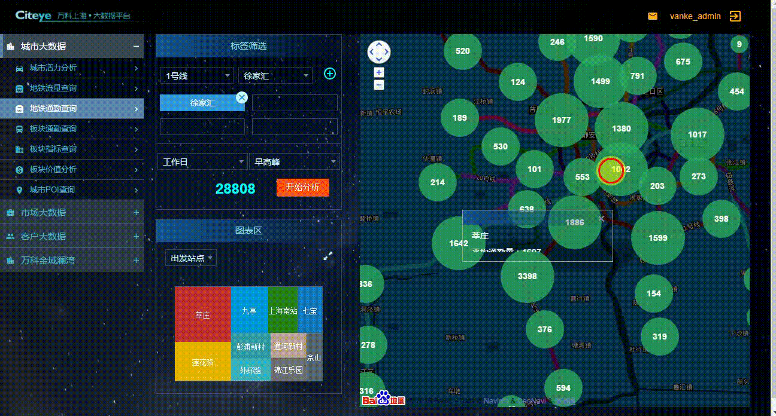
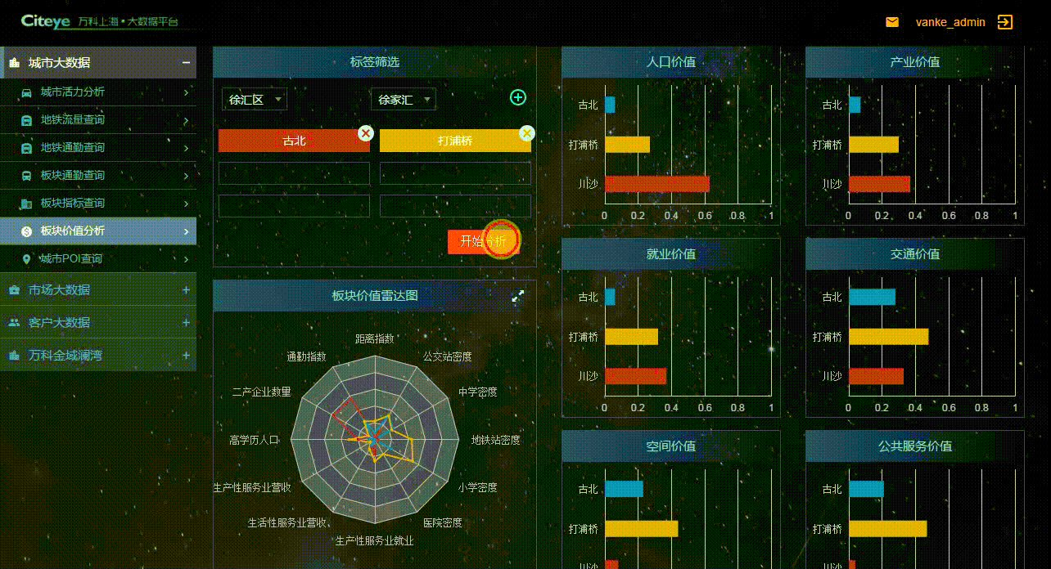
Handling Redundancy in Data Integration

Slide 6
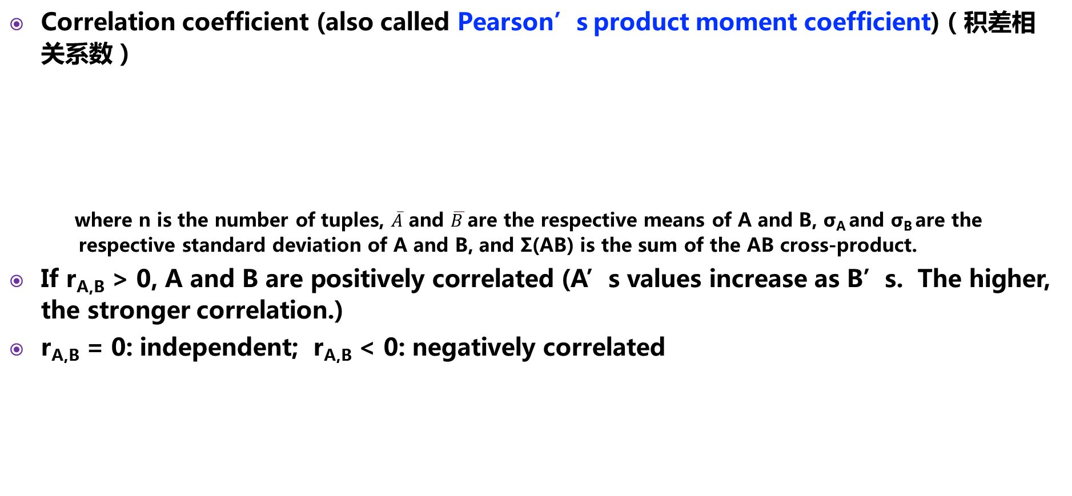
Correlation Analysis (Numerical Data)
Correlation coefficient (also called Pearson’s product moment coefficient)（积差相关系数）
where n is the number of tuples, $\overline{A}$ and $\overline{B }$are the respective means of A and B, σ_{A} and σ_{B} are the respective standard deviation of A and B, and Σ(AB) is the sum of the AB cross-product.
If r_{A,B} > 0, A and B are positively correlated (A’s values increase as B’s. The higher, the stronger correlation.)
r_{A,B} = 0: independent; r_{A,B} < 0: negatively correlated

Slide 7

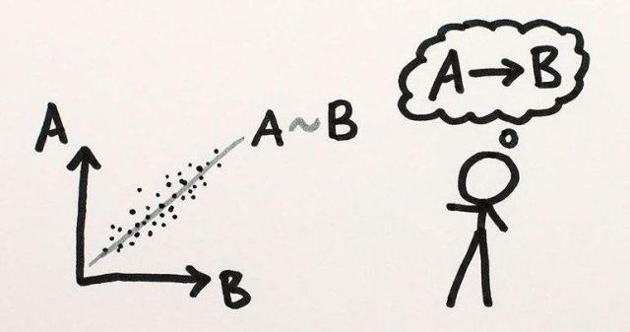
Correlation Analysis (Categorical Data)
Χ² (chi-square，卡方检验) test
The larger the Χ² value, the more likely the variables are related
The cells that contribute the most to the Χ² value are those whose actual count is very different from the expected count
Correlation does not imply causality（因果关系）
# of hospitals and # of car-theft in a city are correlated
Both are causally linked to the third variable: population（人口）

Slide 8
Chi-Square Calculation: An Example
 | Play chess | Not play chess | Sum (row)
Like science fiction | 250(90) | 200(360) | 450
Not like science fiction | 50(210) | 1000(840) | 1050
Sum(col.) | 300 | 1200 | 1500
Χ2 (chi-square) calculation (numbers in parenthesis are expected counts calculated based on the data distribution in the two categories)
It shows that like_science_fiction（科幻小说） and play_chess are correlated in the group

Slide 9
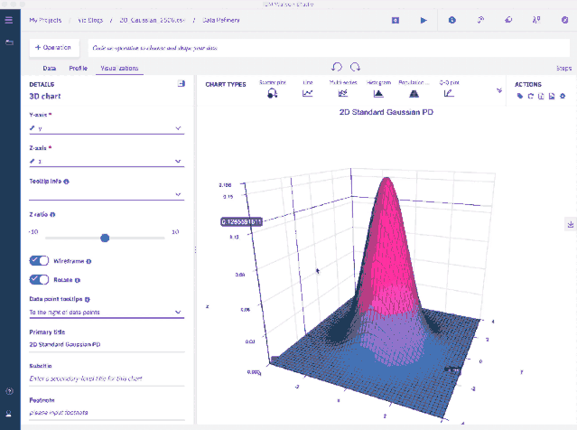
Data Transformation
Smoothing（平滑）: remove noise from data
Aggregation（聚合）: summarization, data cube construction
Generalization（泛化）: concept hierarchy climbing
Normalization（规范化）: scaled to fall within a small, specified range
min-max normalization
z-score normalization
normalization by decimal scaling
Attribute/feature construction
New attributes constructed from the given ones

Slide 10
Data Transformation: Normalization
min-max normalization
z-score normalization (μ: mean, σ: standard deviation)
normalization by decimal scaling
,where j is the smallest integer such that Max(|ν’|) < 1

Slide 11
Thanks！
Notes:
工作新意图发现

